Slide 1
Transfer Pytorch and Tensorflow Model to Jetson
Jovan Hermawan & Zhang Han
18/09/2020

Slide 2

Integrated with every framework
Rely on GPU-accelerated libraries such as cuDNN and TensorRT to deliver high-performance on GPU

Slide 3
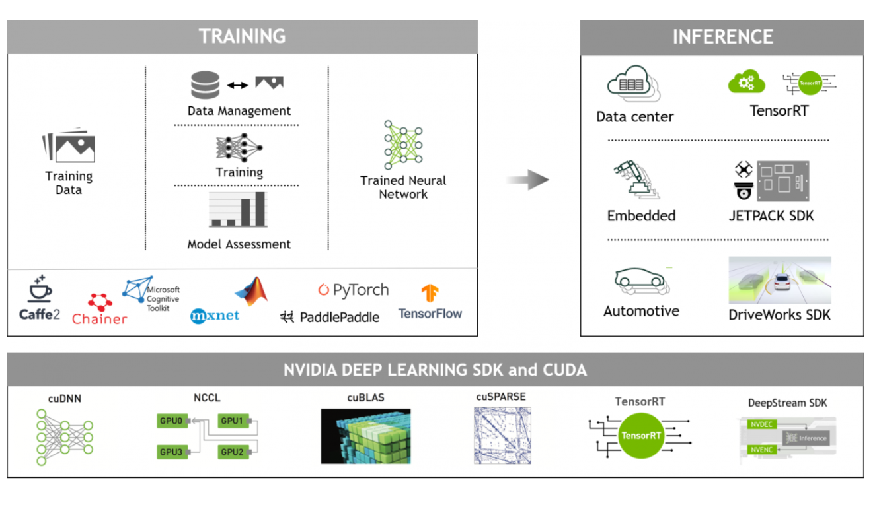

Slide 4
CUDA-X AI libraries and SDKs
Libraries: DALI, cuDNN, NCCL, NeMo, Transfer Learnign Toolkit, DIGITS, AI-Assisted Annotation Toolkit
SDKs: TensorRT, DeepStream SDK, NVIDIA Triton Inference Server, NVIDIA Jarvis
NGC: the hub for GPU-optimized software for deep learning and machine learning.

Slide 5
Pytorch
1st part：

Slide 6
Using TensorRT to optimize (PyTorch):
First step : train a model using PyTorch
Second step : convert the model to ONNX format
Third step : use NVIDIA TensorRT for inference

Slide 7

What is ONNX?
Open format built to represent machine learning models.
Machine learning models > ONNX
Images > JPEG

Slide 8
Converting Pytorch Model to TensorRT
Load and launch the pretrained model

Slide 9
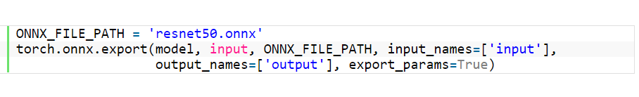
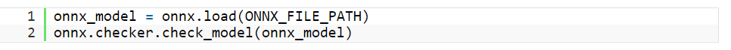
2.Convert the PyTorch model to ONNX format

Slide 10

3.Visualize ONNX Model
python3 -m pip install netron
type netron in command line
open http://localhost:8080/

Slide 11
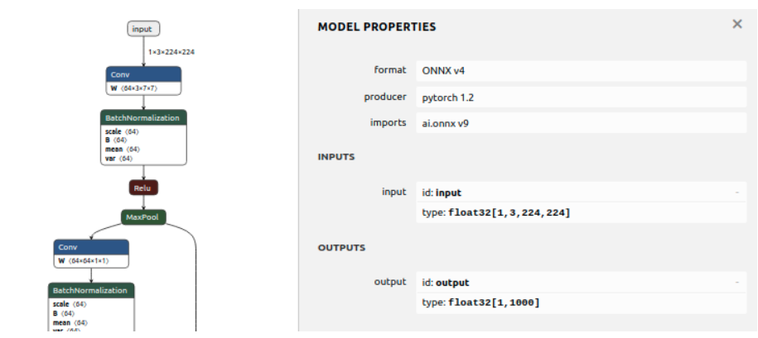

Slide 12
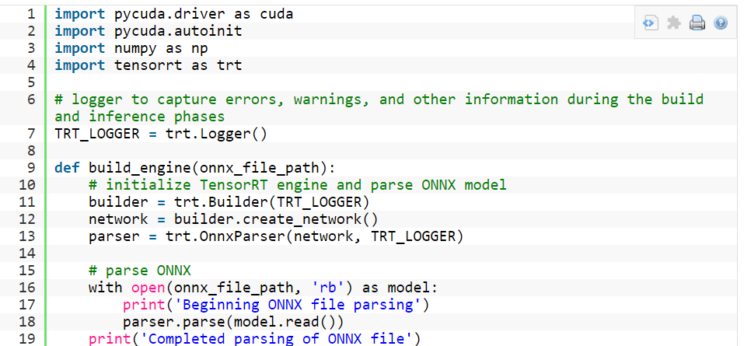
4. Initialize model in TensorRT

Slide 13
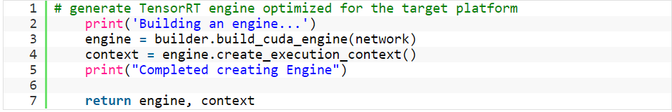

Slide 14
Tensorflow
2nd part：

Slide 15
On our laptops
Train Tensorflow model
Build TensorRT / Jetson compatible graph
Optimize with TensorRT

Slide 16
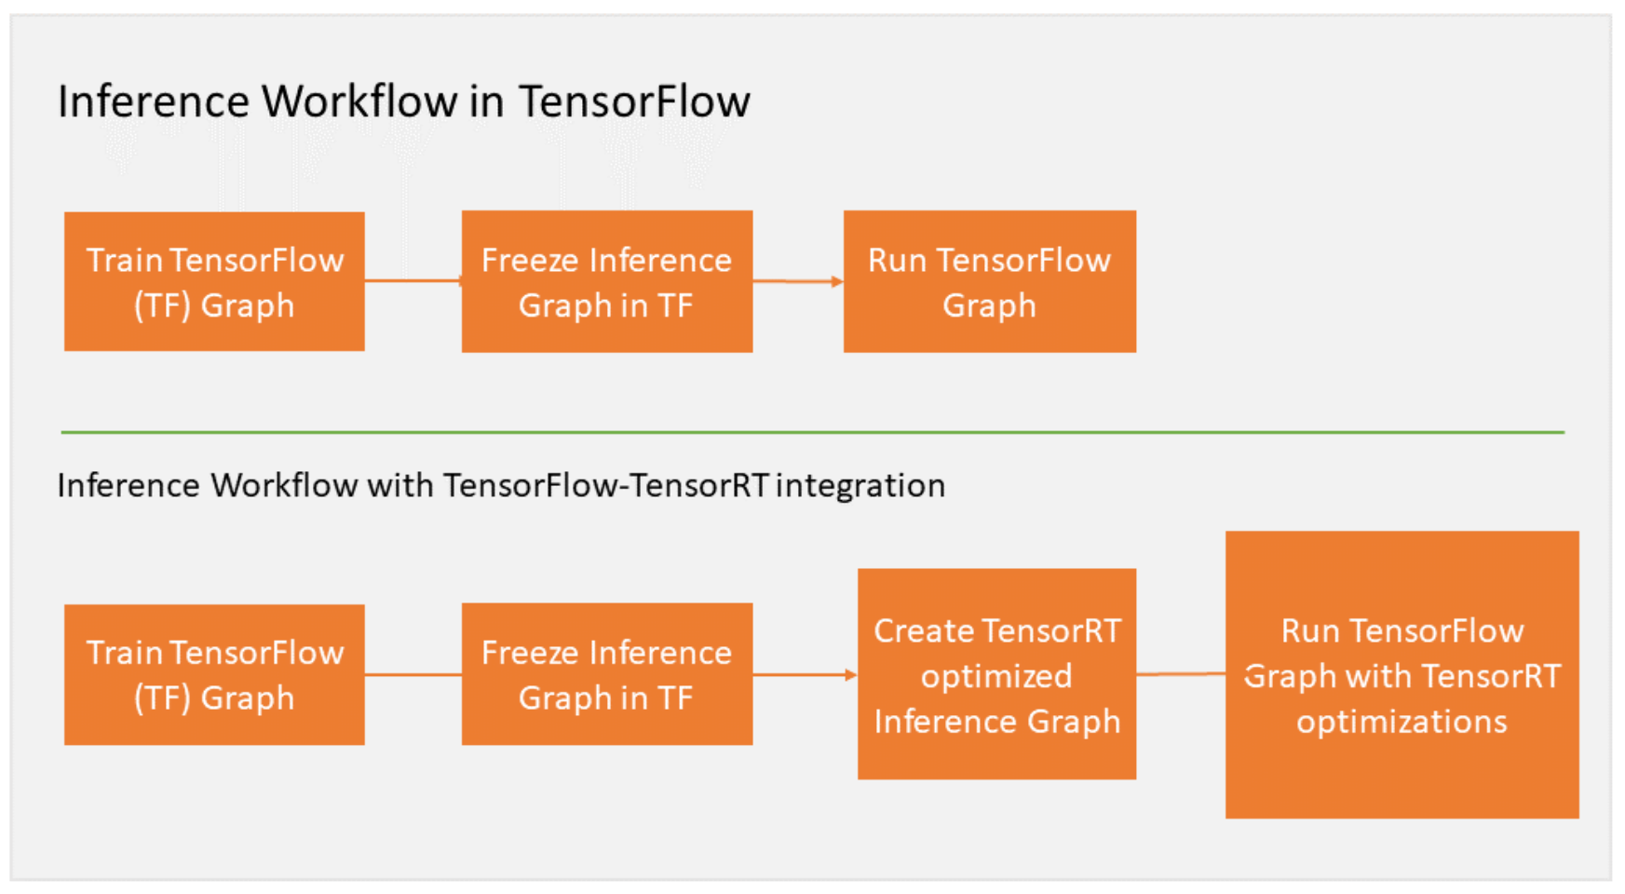
Workflow

Slide 17
Apply TensorRT optimizations to TensorFlow graph
Specify the fraction of GPU
gpu_options = tf.GPUOptions(per_process_gpu_memory_fraction = number_between_0_and_1)
Indicates the fraction of GPU memory allowed for TensorFlow, TensorRT can use the remaining memory.

Slide 18
Apply TensorRT optimizations to TensorFlow graph
2. TensorRT analyze the TensorFlow graph and apply optimizations
trt_graph = trt.create_inference_graph(
input_graph_def=frozen_graph_def,
outputs=output_node_name,
max_batch_size=batch_size,
max_workspace_size_bytes=workspace_size,
precision_mode=precision)
TensorRT takes a frozen TensorFlow graph as input and returns an optimized graph with TensorRT nodes.

Slide 19
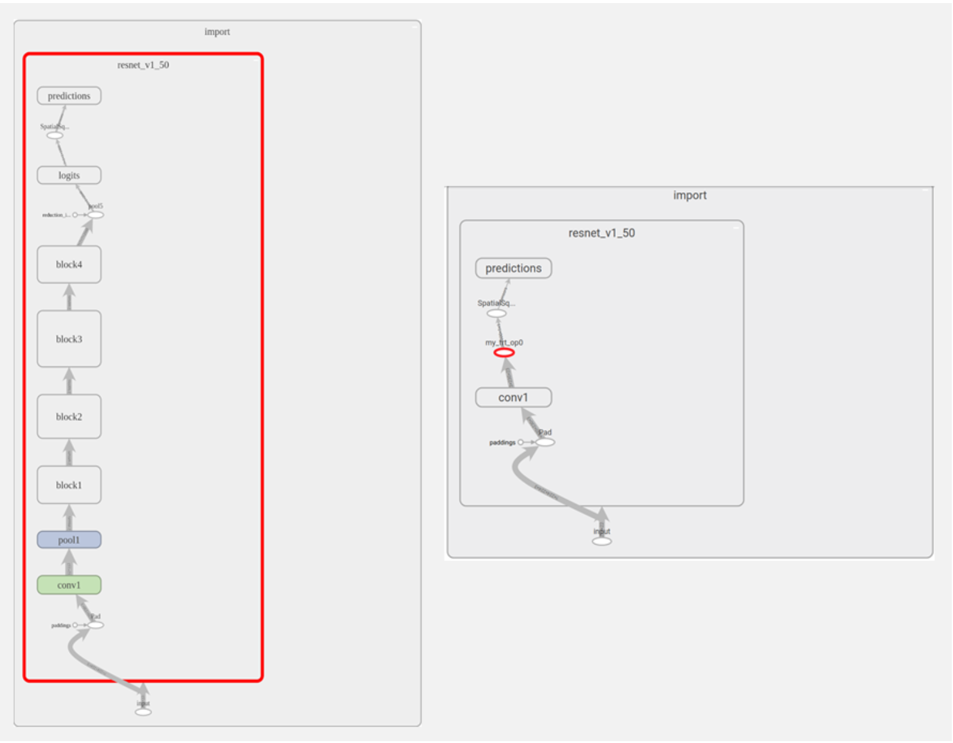

Slide 20
create_inference_graph function parameters
frozen_graph_def: frozen TensorFlow graphout
put_node_name: list of strings with names of output nodes e.g. “resnet_v1_50/predictions/Reshape_1”]
max_batch_size: integer, size of input batch e.g. 16
max_workspace_size_bytes: integer, maximum GPU memory size available for TensorRT
precision_mode: string, allowed values “FP32”, “FP16” or “INT8”

Slide 21
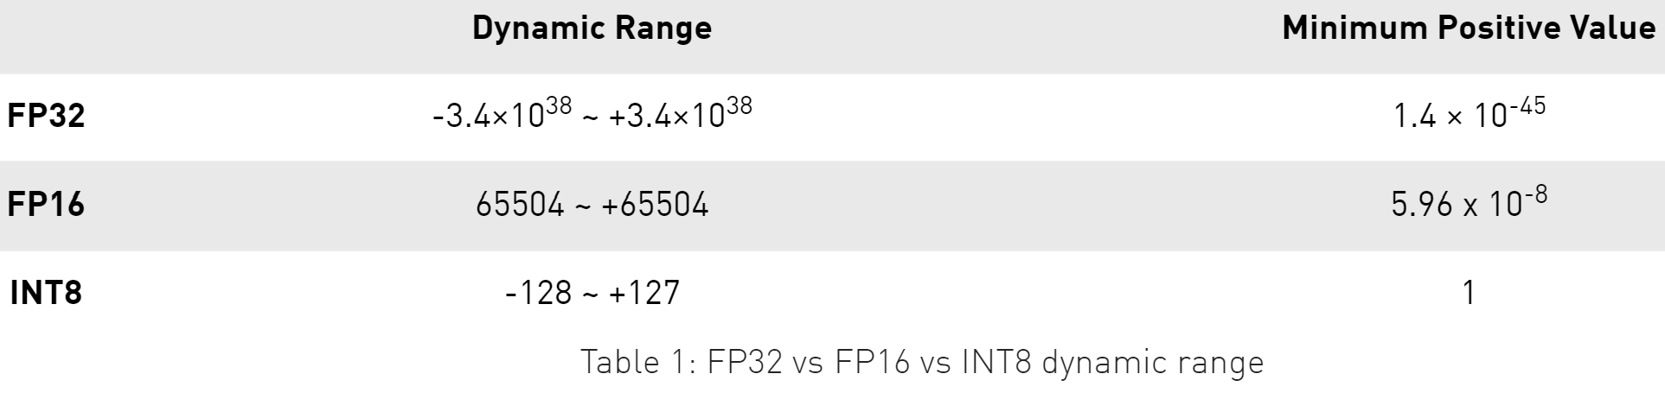
Precision_mode
“ FP32” : single-precision
“ FP16” : half-precision, reduces memory usage, allows deployment of larger networks, and takes less time
“ INT8”: further improves computation speed and places lower requirements on bandwidth

Slide 22
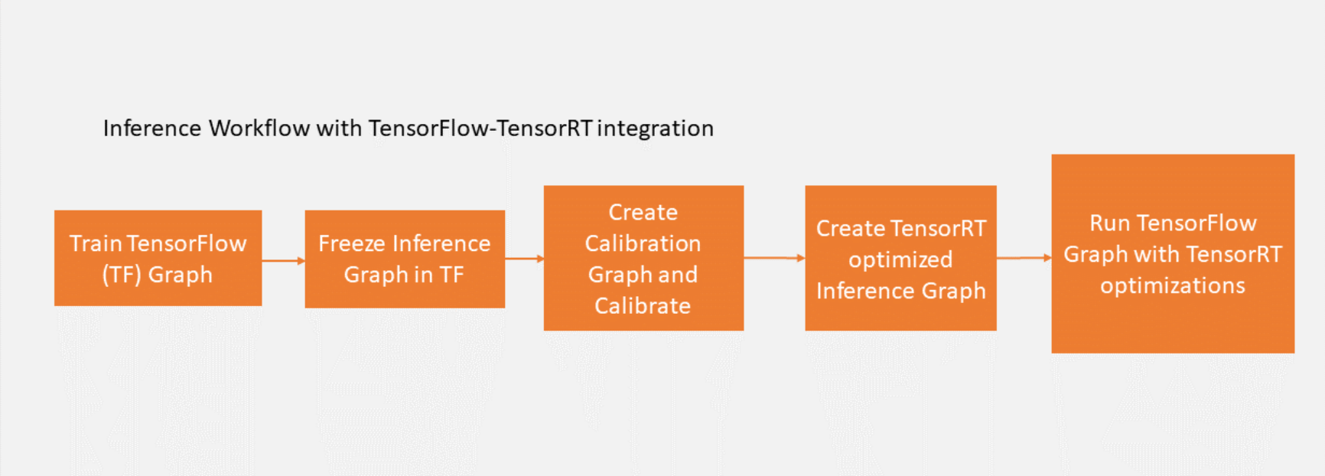
TensorRT provides capabilities to take models trained in single (FP32) and half (FP16) precision and convert them for deployment with INT8 quantizations while minimizing accuracy loss.
Next, execute the calibration graph with calibration data.

Slide 23
On Jetson Xavier NX
Installation
Open graph.pb file from Google Colab on Jetson Xavier NX
from google.colab import files
files.download('......')

Slide 24
Preparation
connect to power supply
connect with keyboard, mouse and monitor screen
SSD card
JetPack 4.4

Slide 25
Installation
Install and upgrade pip3
$ sudo apt-get install python3-pip
$ sudo pip3 install -U pip testresources setuptools
Install Python
$ sudo pip3 install -U numpy==1.16.1 future==0.18.2 mock==3.0.5 h5py==2.10.0 keras_preprocessing==1.1.1 keras_applications==1.0.8 gast==0.2.2 futures protobuf pybind11

Slide 26
Installation
Install system packages required by TensorFlow
$ sudo apt-get update
$ sudo apt-get install libhdf5-serial-dev hdf5-tools libhdf5-dev zlib1g-dev zip libjpeg8-dev liblapack-dev libblas-dev gfortran
Install TensorFlow
$ sudo pip3 install --pre --extra-index-url https://developer.download.nvidia.com/compute/redist/jp/v44 tensorflow

Slide 27
Thanks

